Slide 1
A Project Report On
“IQ Test”
(FY-MCA | Semester-1 Mini Project)

Slide 2
Description
An IQ test project typically involves the development and implementation of
a standardized intelligence quotient (IQ) test. The aim is to measure a
person's cognitive abilities in various domains, including logical reasoning,
problem-solving, memory, and verbal comprehension. The project may
include the creation of a diverse set of test questions.

Slide 3
INTRODUCTION
01
Problem Definition
02
Objectives
03
Scope

Slide 4
Requirement and analysis
PROBLEM DEFINITION
USECASE DIAGRAM
CLASS DIGRAM
DFD DIAGRAM
ER DIAGRAM
SEQUENCE DIAGRAM
ACTIVITY DIAGRAM

Slide 5
Survey Of Technology
Technology Used
→ HTML
→ CSS
→ TAILWIND CSS
→ JAVASCRIPT

Slide 6
About Proposed System
User registration and authentication
User interactive interface
Adaptive Questionnaire
Innovative UI designs
Strategic roadmap

Slide 7
Modules
Registration Page
Login Page
Home Page
Main Page
Quiz Page
Database Maintenance
User score Page

Slide 8

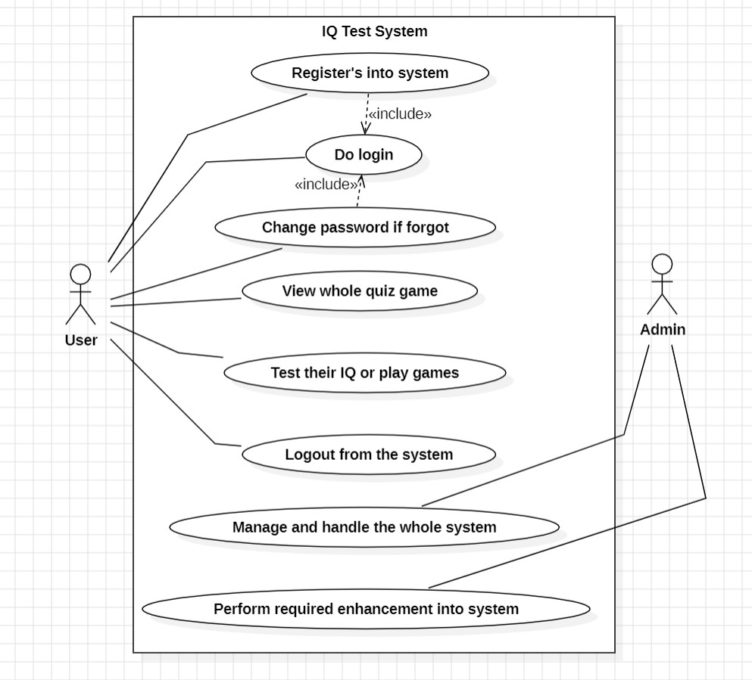
USECASE DIAGRAM
A use case diagram is a visual representation in Unified Modeling Language (UML) that illustrates the interactions between a system and its users or external entities.

Slide 9
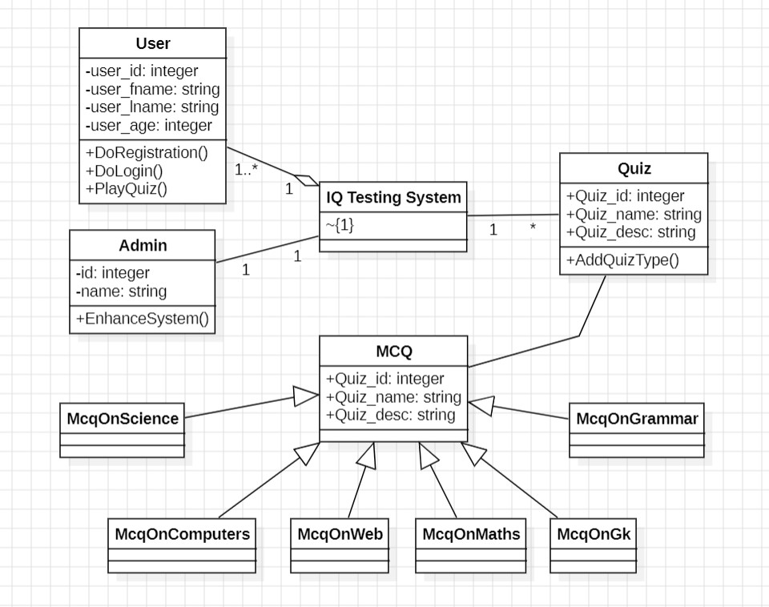
CLASS DIAGRAM
A class diagram in Unified Modeling Language (UML) is a visual representation that depicts the structure and relationships among classes in a system.

Slide 10
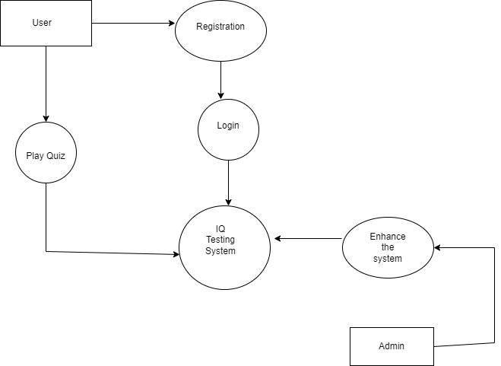
DFD DIAGRAM
A Data Flow Diagram (DFD) is a visual representation that illustrates how data moves through a system, depicting processes, data stores, data flow, and external entities.

Slide 11
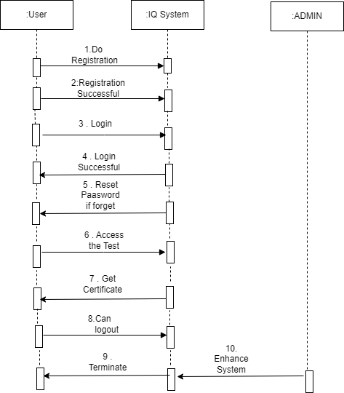
SEQUENCE DIAGRAM
A Sequence Diagram in Unified Modeling Language (UML) visually represents the interactions and order of messages exchanged between objects or components within a system. I.

Slide 12
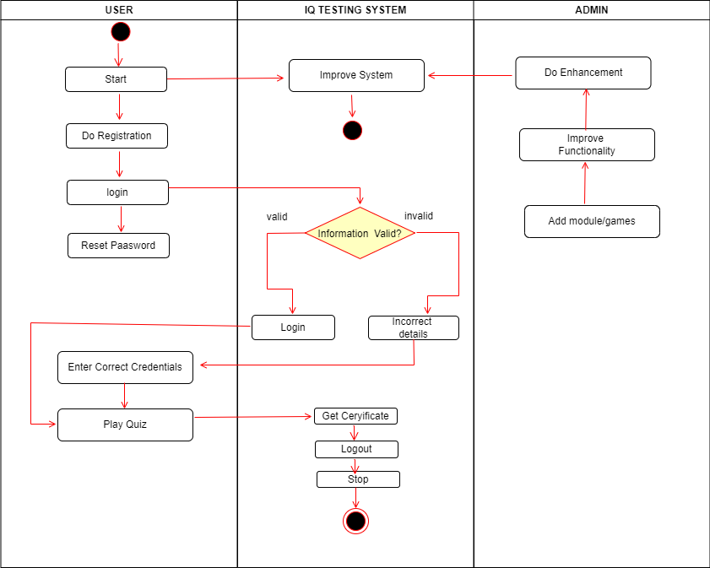
ACTIVITY DIAGRAM
An Activity Diagram in Unified Modeling Language (UML) is a visual representation that showcases the flow of activities and actions within a system or business process.

Slide 13
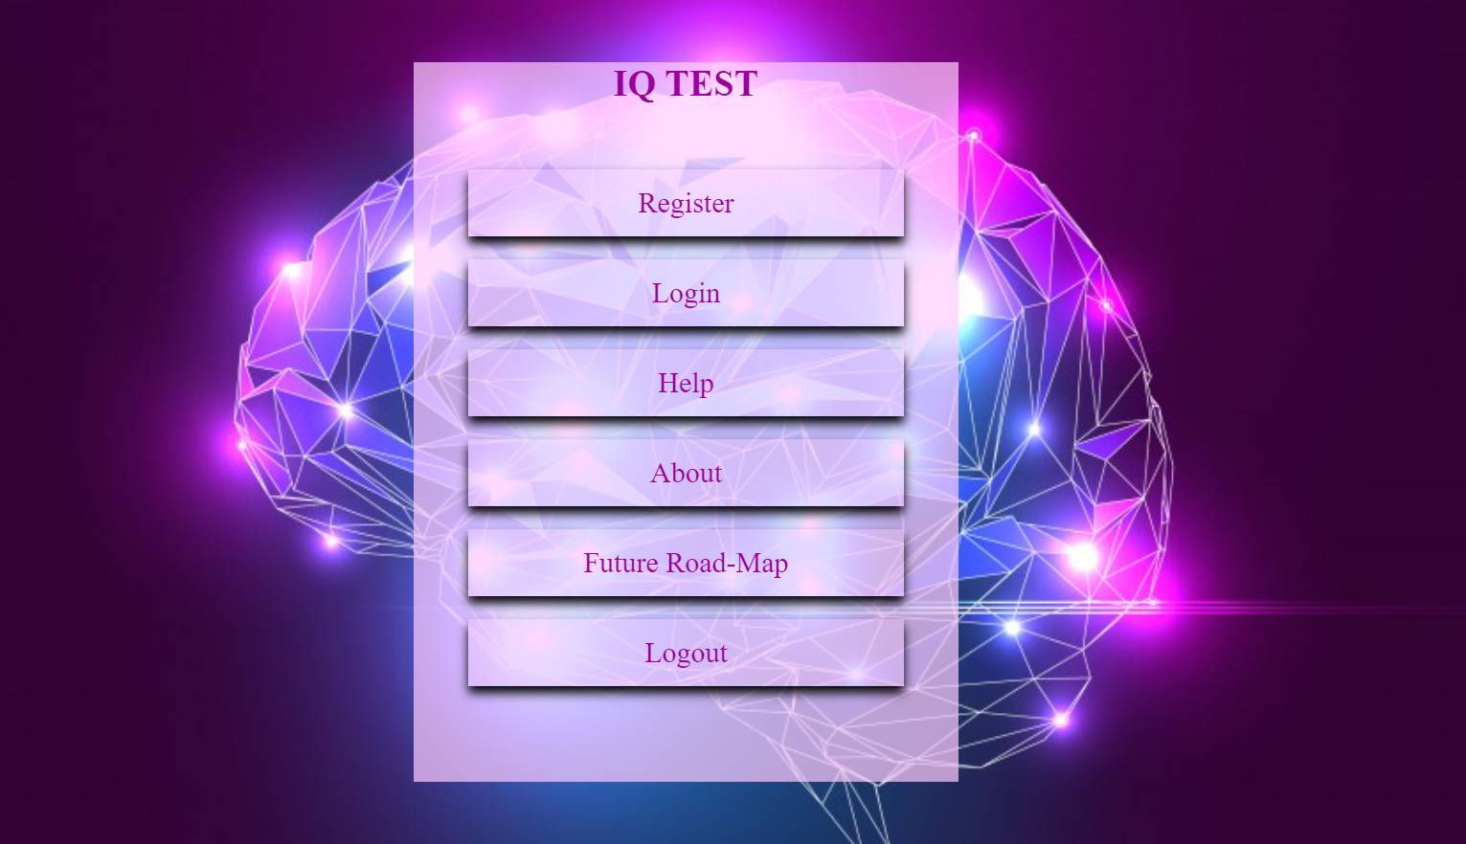
USER INTERFACE!

Slide 14
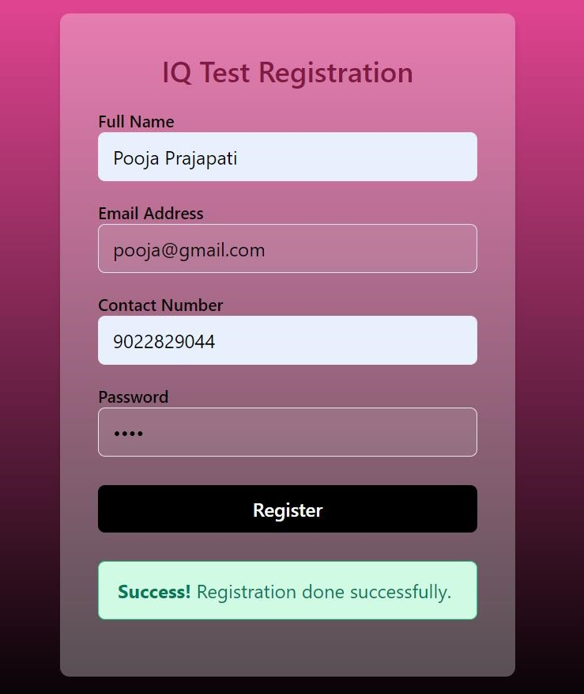
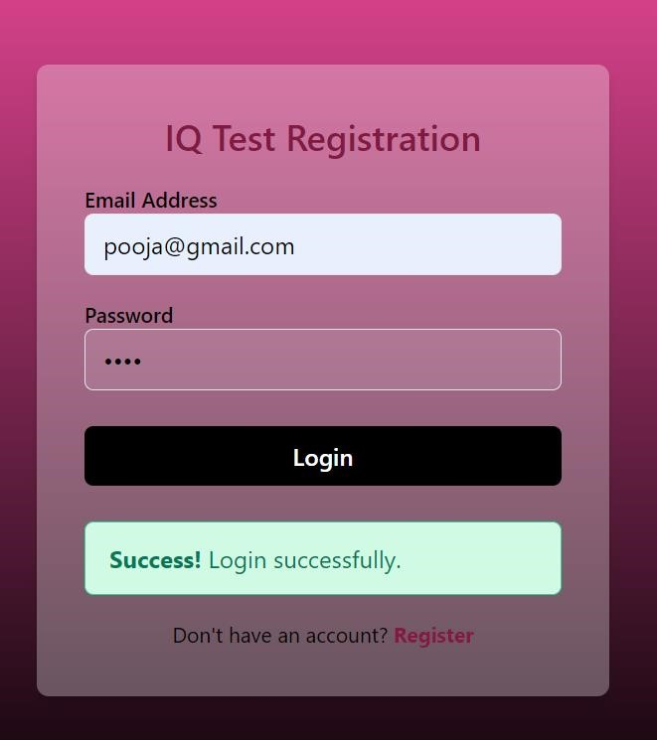
USER REGISTRATION
USER LOGIN

Slide 15
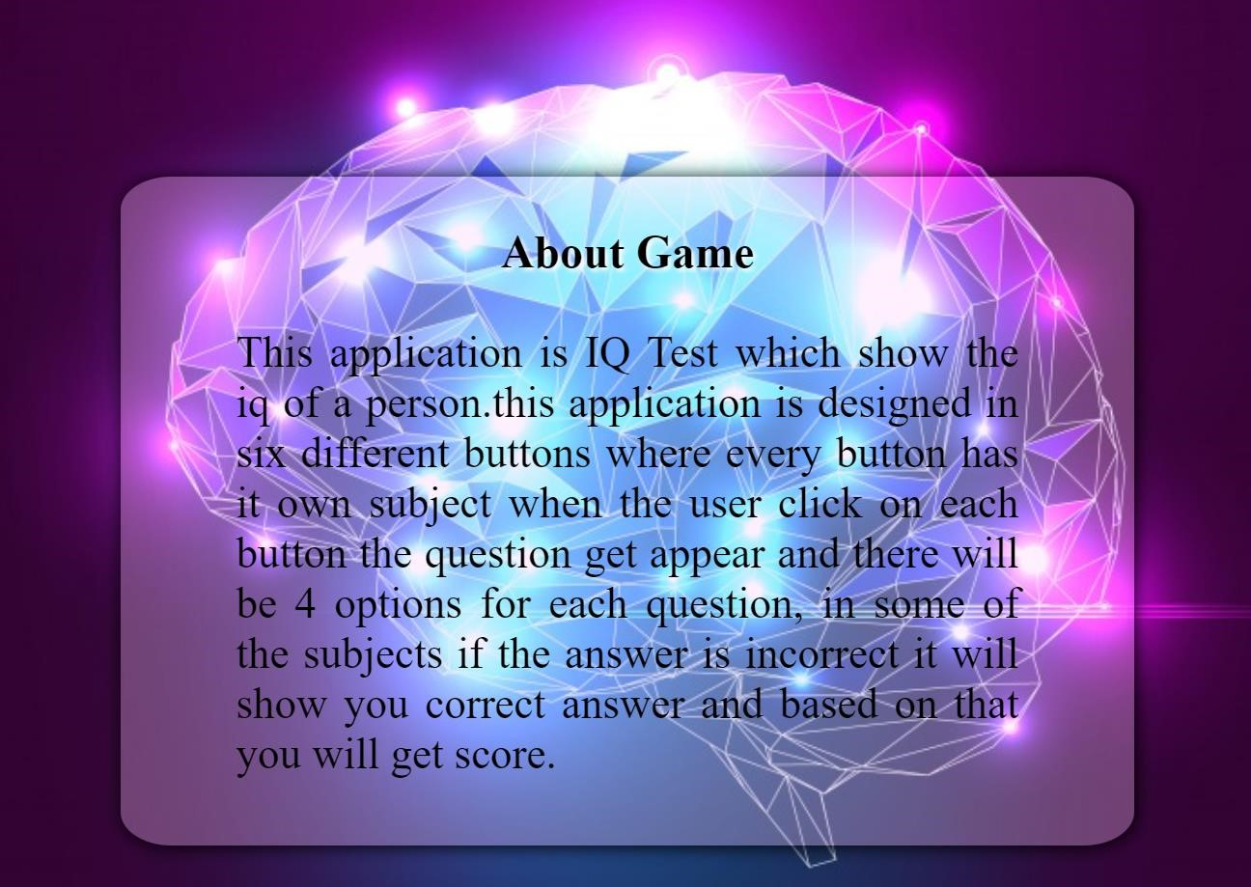
HELP MODULE

Slide 16

ABOUT US

Slide 17
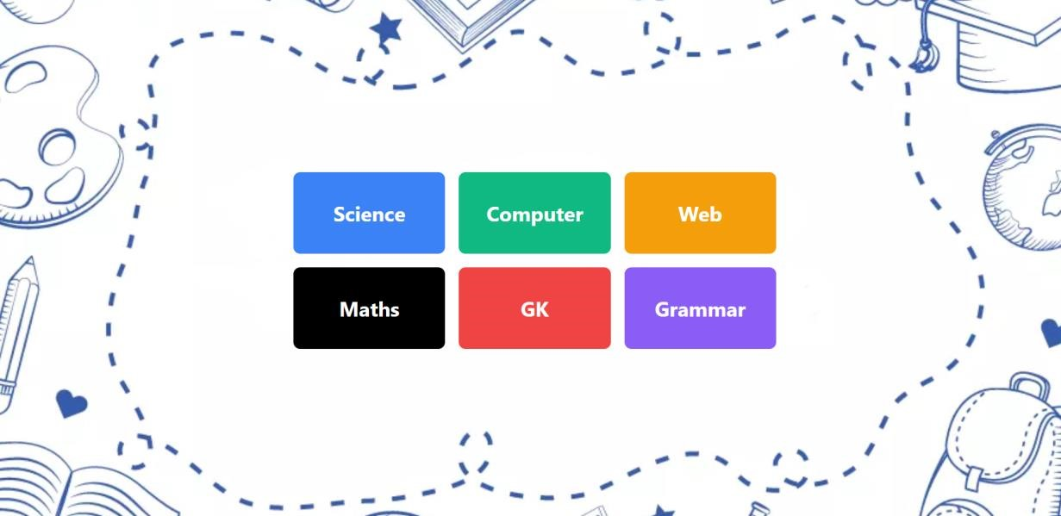
MCQ MODULE

Slide 18
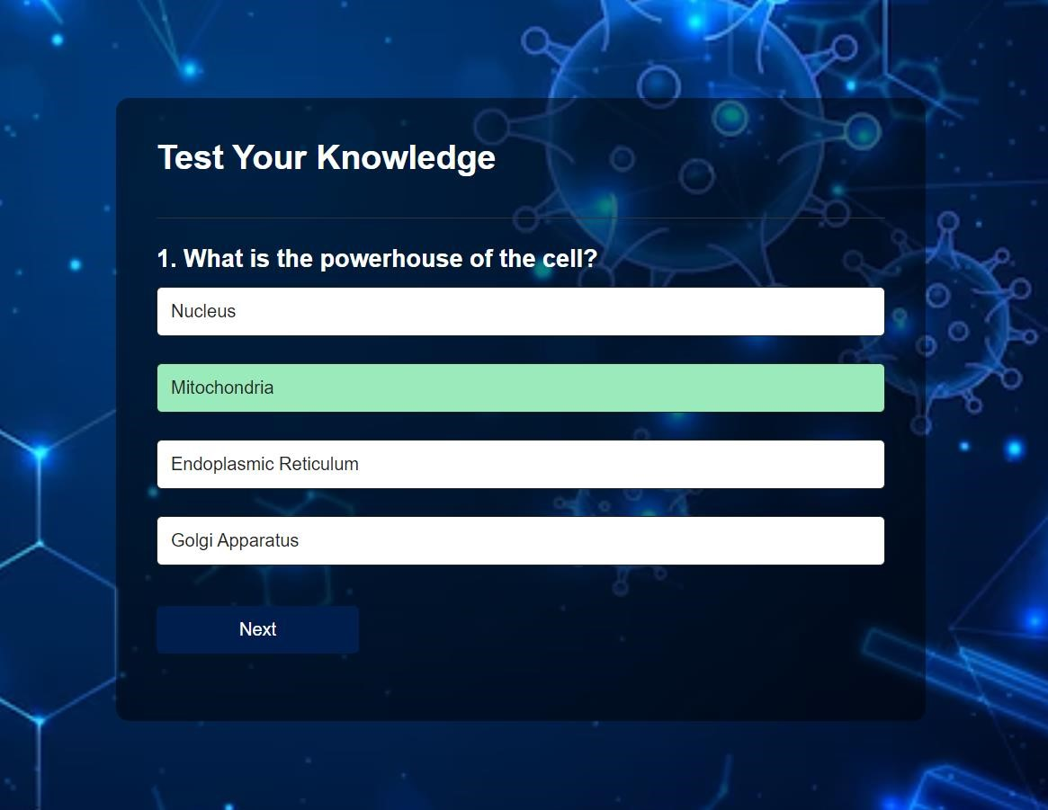
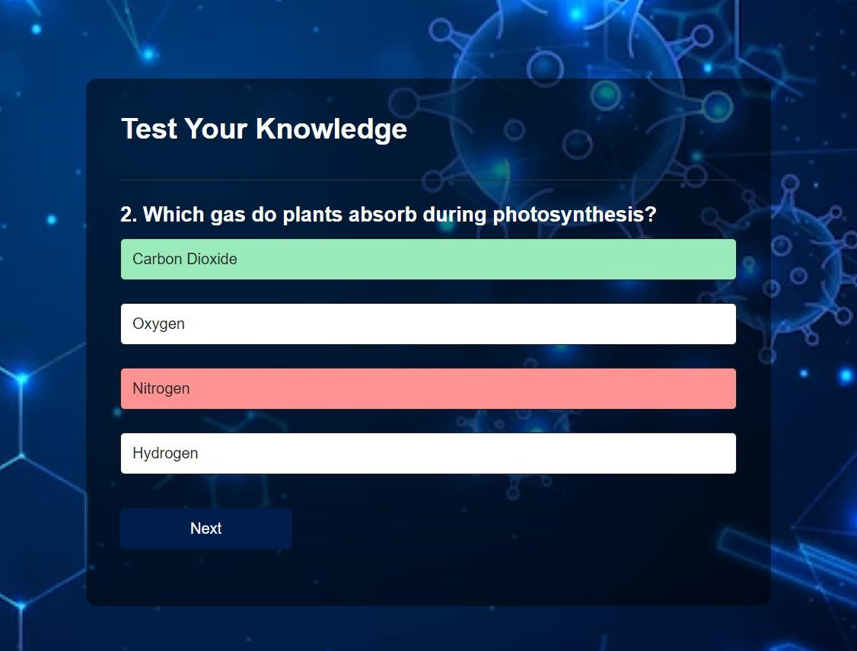
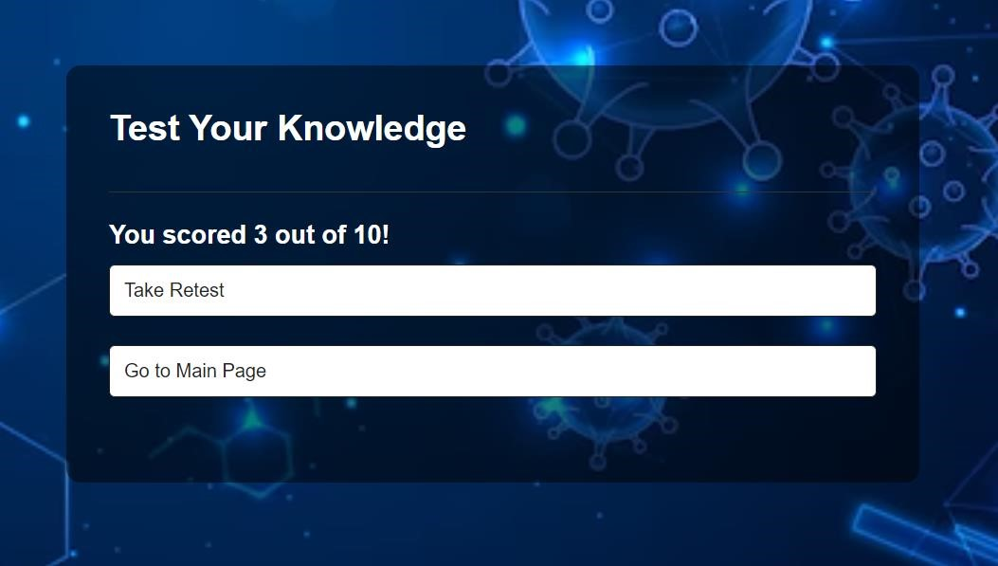
SCIENCE QUIZ

Slide 19
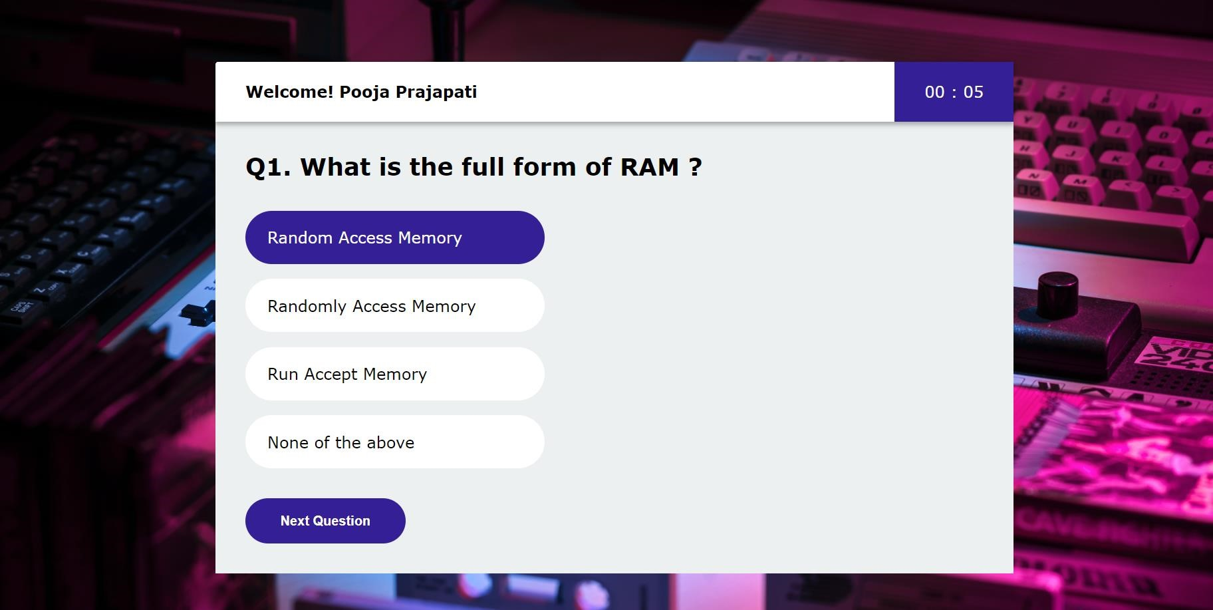
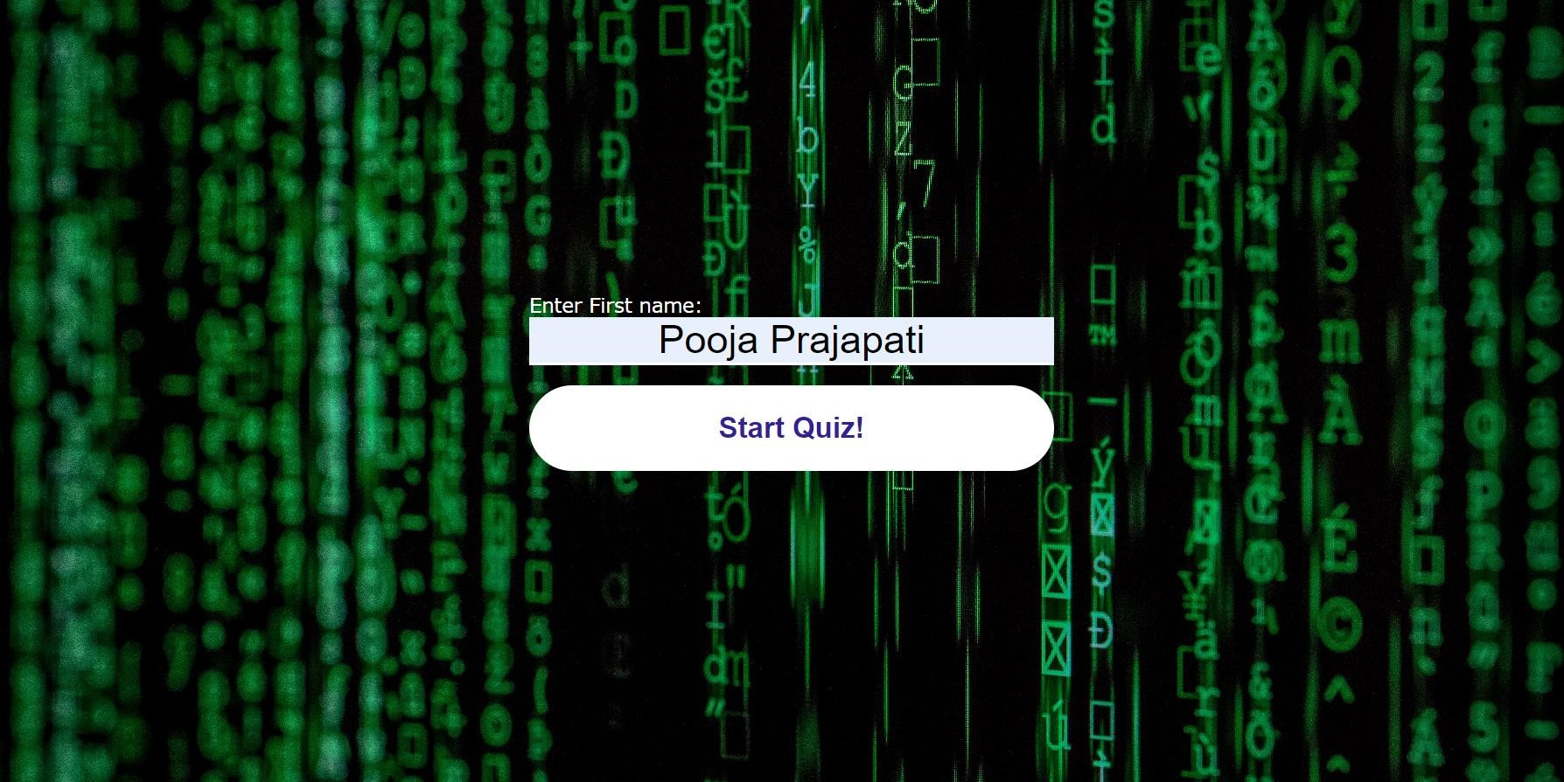

COMPUTER QUIZ

Slide 20
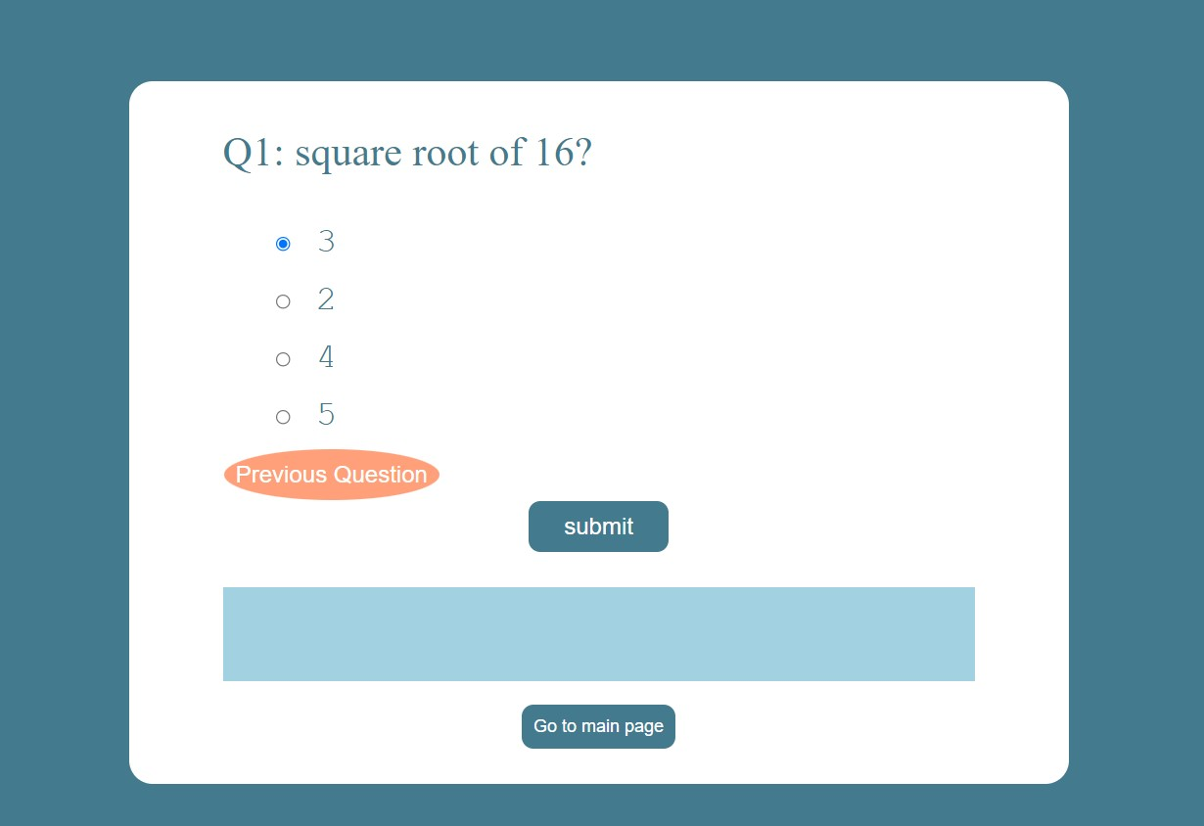
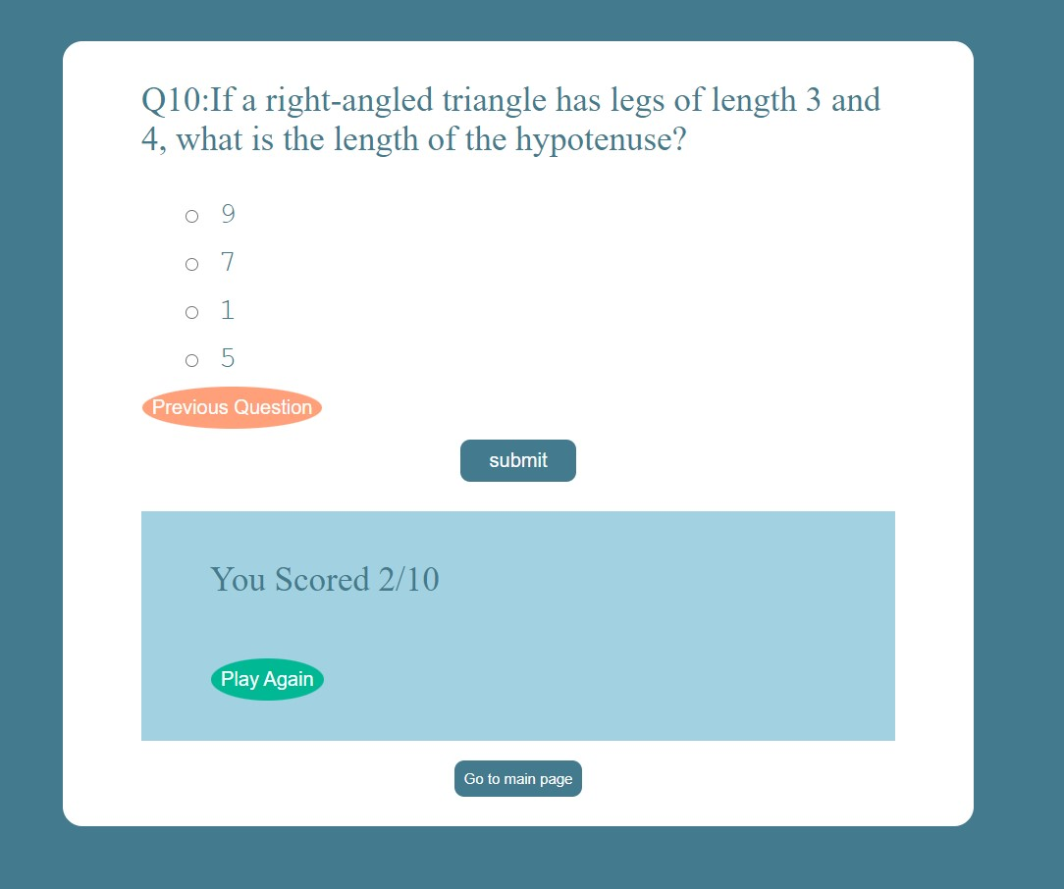
MATHS QUIZ

Slide 21
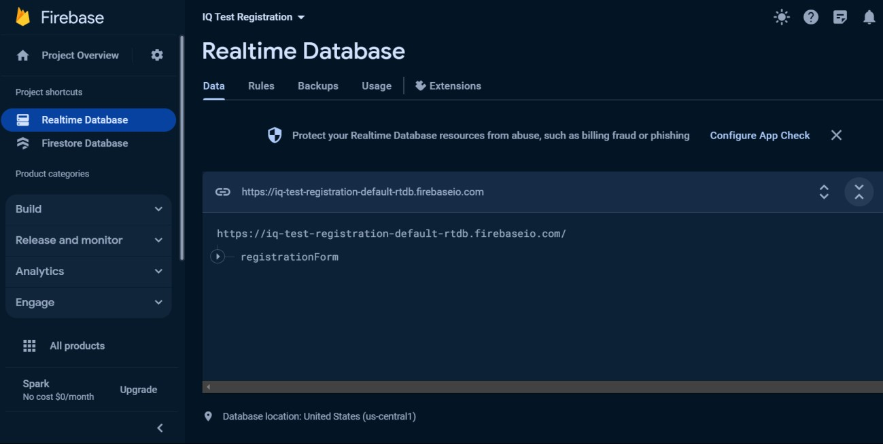
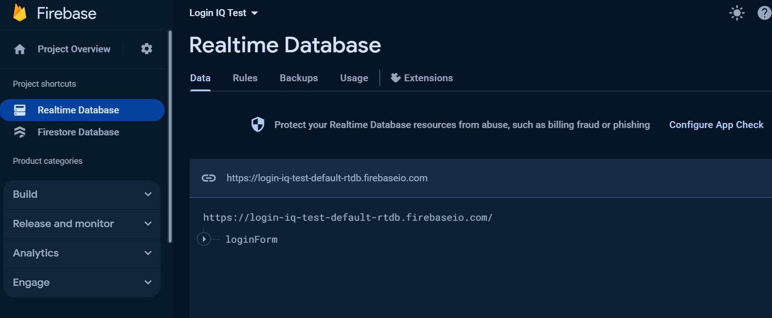
DATABASE
Firebase: Firebase is a NoSQL database service that doesn't use tables in the same way as traditional relational databases like SQL. Instead of tables, Firebase Realtime Database and Firestore use a JSON-like structure to store data.

Slide 22
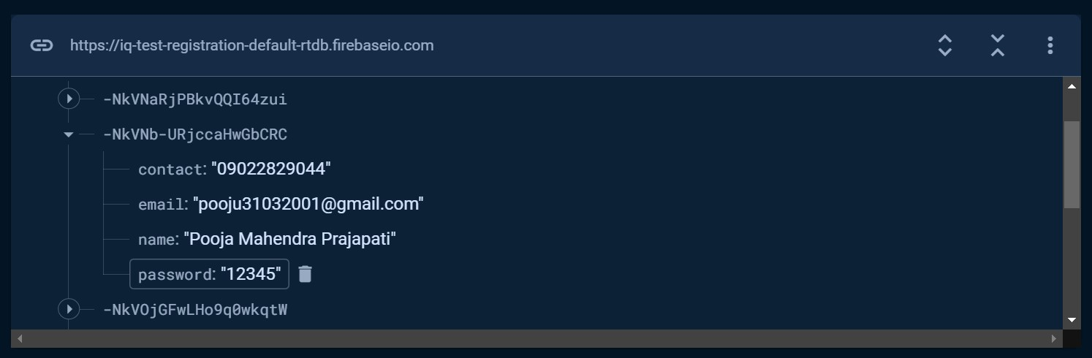
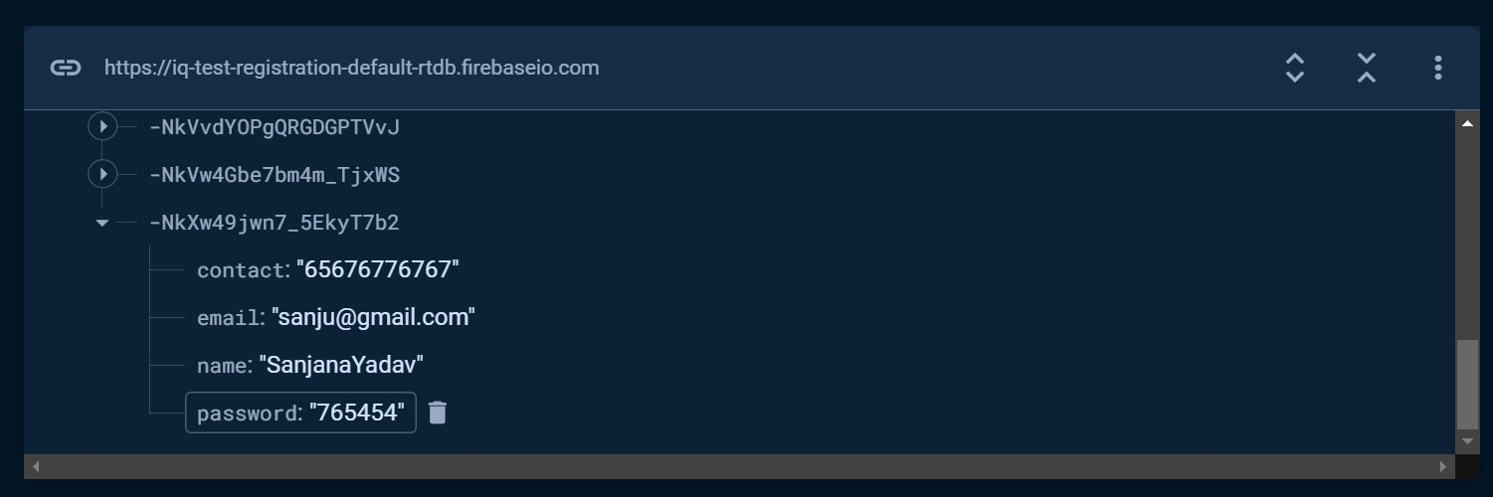

Slide 23
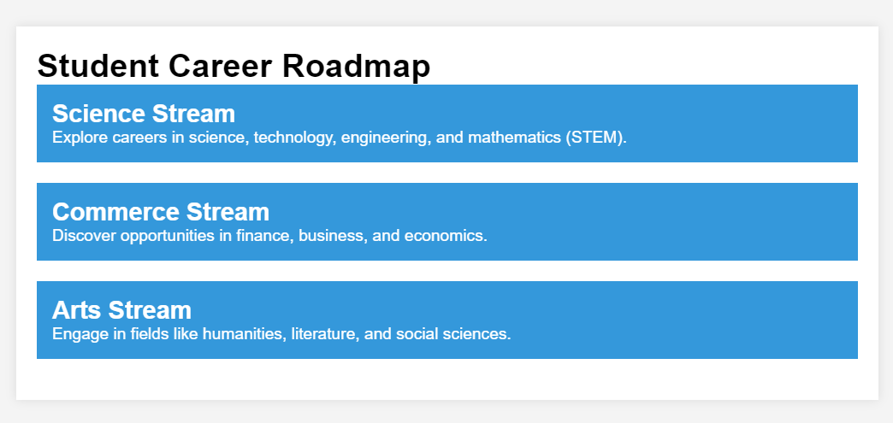
CAREER ROADMAP

Slide 24
CONCLUSION
"In conclusion, our IQ test project aimed to provide an engaging and comprehensive assessment of cognitive abilities.
we created a tool that value insights into individuals intellectual strengths.
Through this project we recognize the potential impact on personal and professional development

Slide 25
FUTURE ENHANCEMENT
Advanced Question Types
Personalized Feedback
Security Measures
Internet connectivity
Integration with Educational Platforms

Slide 26
Presented By Ms. Pooja M Prajapati Ms. Sanjana Yadav Under the guidance of Prof. Pradnya Mhatre

Slide 27
Thank You!

